Slide 1
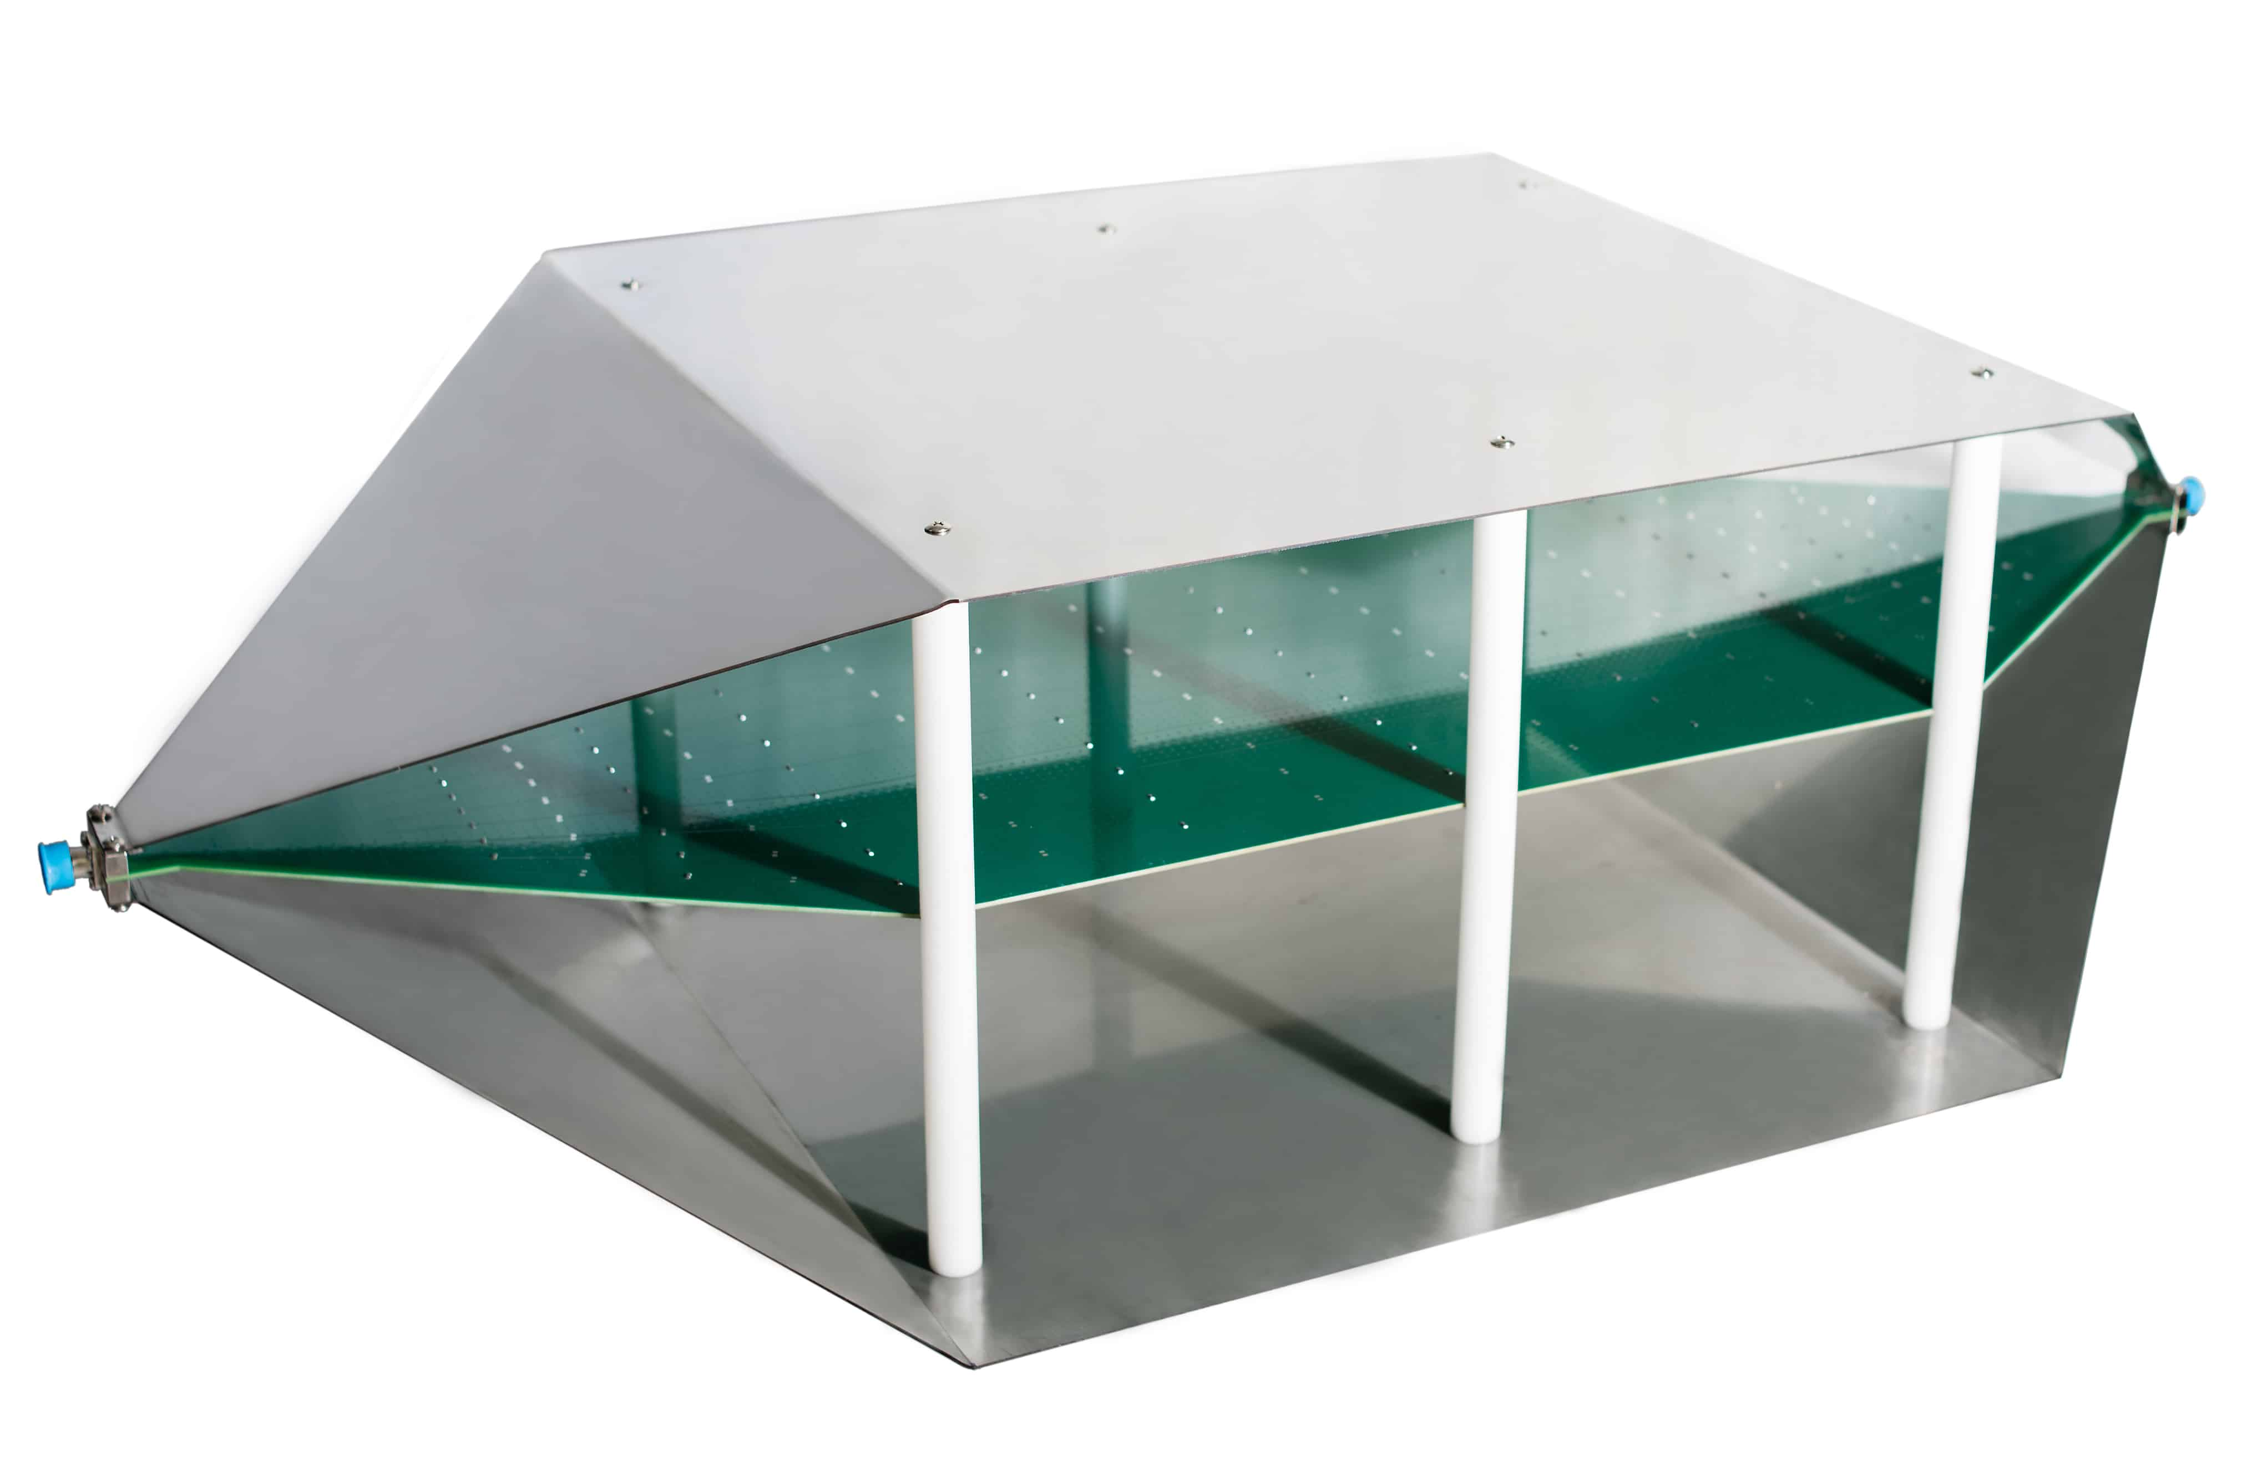
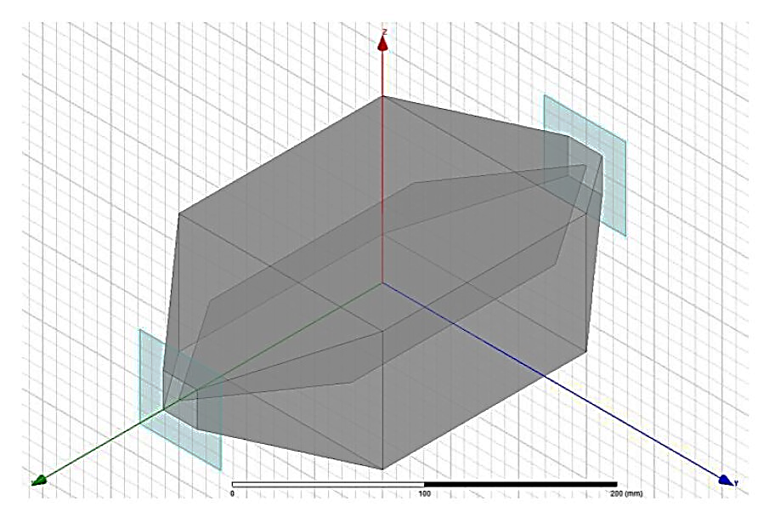
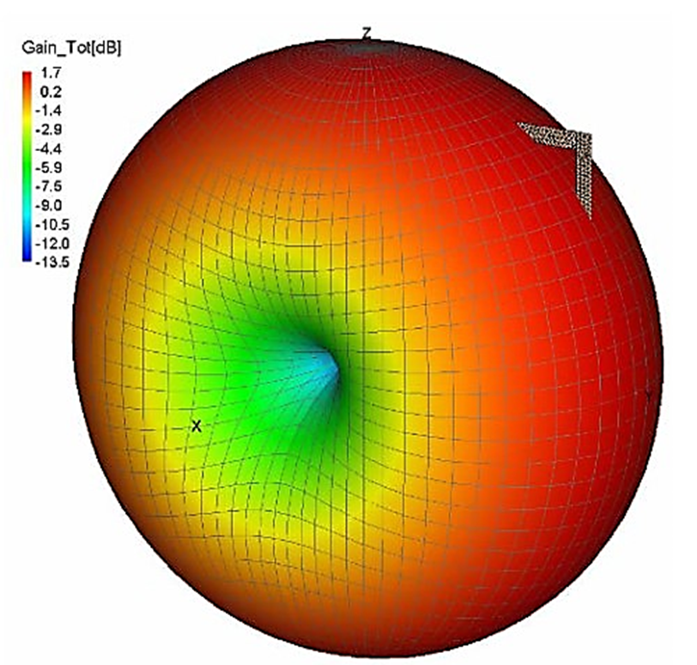
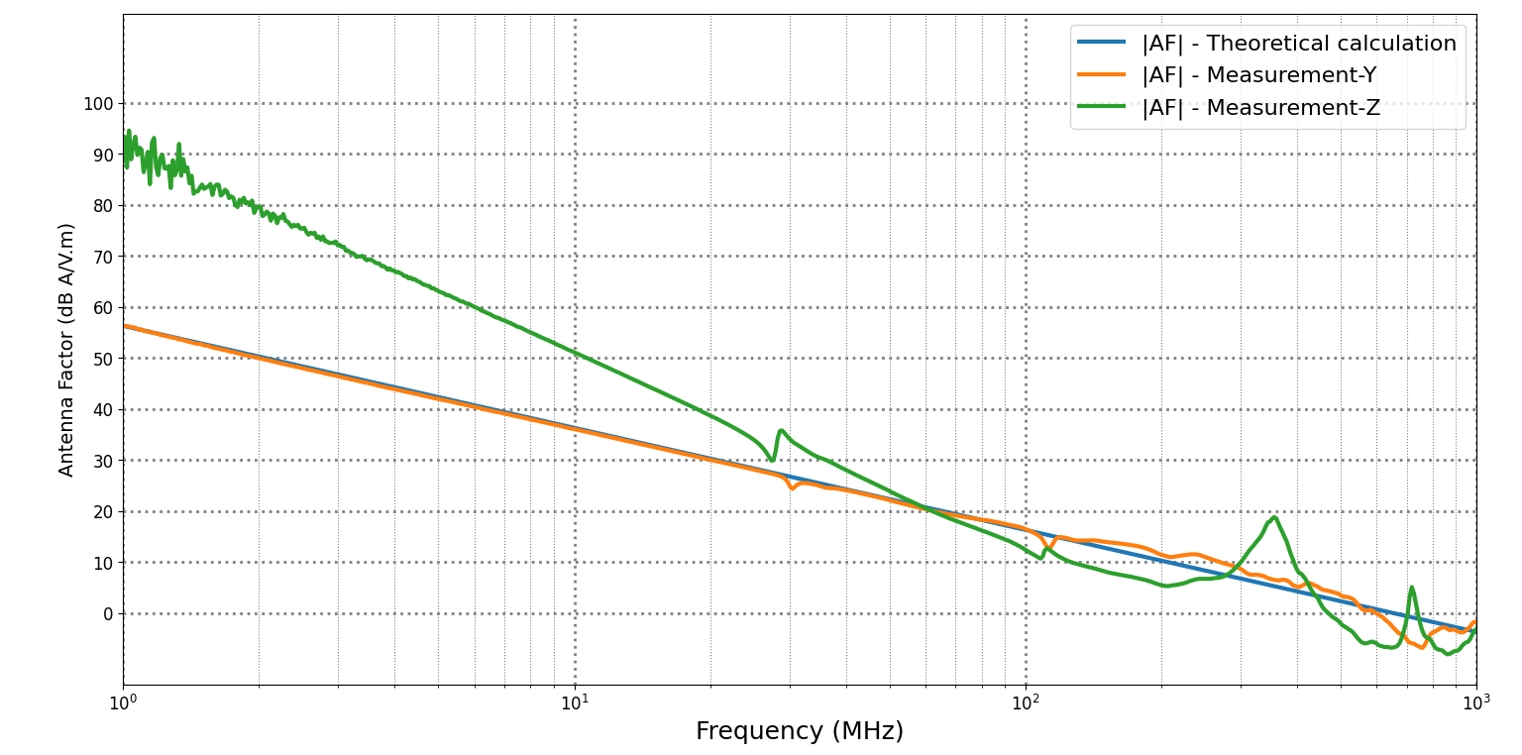
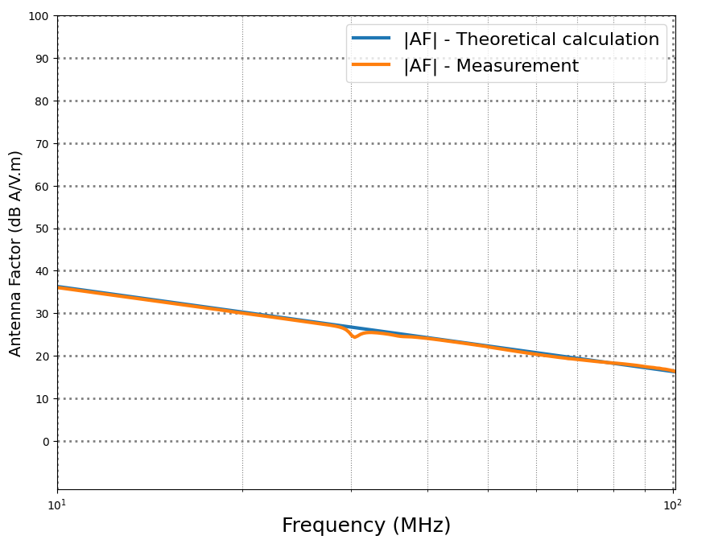
Validation of an Electromagnetic loop probe for Real -Time Diagnostic of Near- Field in Electrical Vehicle
Zaid Jabbar, Fabien Ndagijimana, Aktham Asfour
Univ. Grenoble Alpes, CNRS, Grenoble INP, G2Elab, 38000 Grenoble France
Objectives
Calibration setup
Validation of the probe (loop antenna) used in the Near Field Scan (NFS) assessment of electric vehicles (EVs)
characterization of the loop antenna using a Transversal Electromagnetic (TEM) cell :
determining the resulting bandwidth
Validation of the antenna factor (AF)
Vector Network Analyzer
PORT1
PORT2
TEM CELL
Transversal Electromagnetic Mode (TEM)
Center Point
Antenna Loop Probe
50Ω
Matching load
One terminal of the TEM cell is supplied with a given power from a vector network analyzer (VNA) and the other terminal is connected to a 50 Ω load
The probe is placed inside the cell and it is connected to port 2 of the VNA
The transmission coefficient S21 is measured by the VNA for the calculation of the antenna factor (AF)
TEM cell is used to create an electromagnetic field with known characteristics:
Simplicity of the control of the specifications of the created field
Uniform electromagnetic field inside the cell
immunity against external electromagnetic interferences (EMI)
Results
$$AF =\frac{H_{TEM}}{V_{out }}$$
The antenna factor (AF) is defined by:
Where:
HTEM: magnetic field
Vout : output voltage of the loop
The loop antenna (coil) analyzed is considered to be a small compared to wavelength (< λ/10)
Impedance matching the loop antenna is done using capacitors
Transverse Electromagnetic Mode (TEM) is used for calibration
Using measurements in the TEM cell, the AF be calculated by:
$$AF =\frac{H_{TEM}}{V_{out }}=\frac{\sqrt[2]{\frac{P_{in} . 50}{Z_{0}. h}}}{\sqrt[2]{P_{out}.50}}=\frac{1}{S21} .\frac{1}{Z_{0}.h}$$
Where:
The used loop antenna probe
Pin: input power from the VNA
Z0 : is the characteristic impedance of the TEM cell in ohms
h : height of TEM cell
Pout: measured output power of the antenna loop
S21: measured transmission coefficient
13mm
The theoretical calculation of the AF is given by
AF_{th}=$\frac{1}{2.pi.f.µ0}$
13mm
Where:
F the frequency and µ0 the permeability
Closed-circuit and square- type antenna
Small compared to the wavelength (< λ/10)
The antenna impedance is dominantly inductive (the resistive component is considered negligible)
A capacitor is thus used as a matching element to compensate the inductive reactance and match the loop impedance to 50 Ω
When the probe is positioned so that the surface of the loop is perpendicular to the Y-axis, the measurements of the AF show a strong agreement with the theoretical calculations, especially at high frequencies
When the probe is rotated 90 degrees around the Z–axis, the measurement is totally changed with respect to the theoretical calculation
Conclusion
Validation of the measurement method of the antenna factor (AF)
The measured antenna factor (AF) depends on the position of loop with respect to the orientation of the electromagnetic field inside the TEM cell
14th European Magnetic Sensors and Actuators Conference
Kosice-Slovakia, 24-27 June 2018

